Slide 1
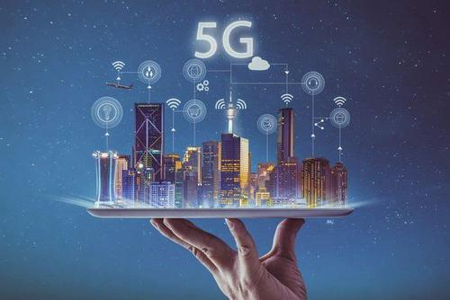


OFDM Technology
Presenter 11911214 杨鸿嘉
11911303 吉辰卿

Slide 2

01
Why we need OFDM？
02
What is OFDM？
03
OFDM Transmitter
CONTENTS
04
OFDM receiver
05-06
Basic Task
07-08
Advanced Task
09
Experience
2

Slide 3

01
Why we need OFDM？
3

Slide 4
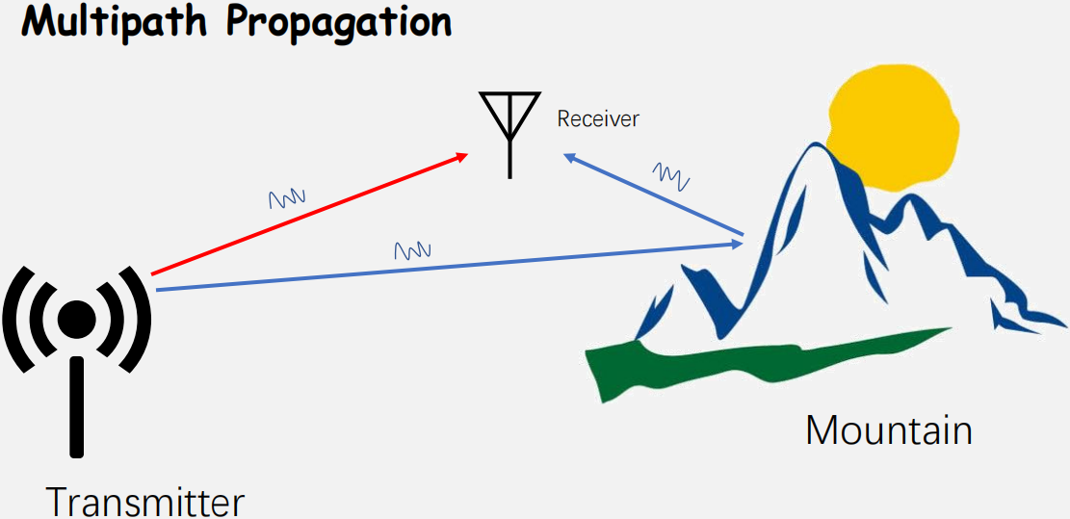
1 Why we need OFDM？
Purpose：Recover the signal x[n] from y[n] under the multipath effect
4

Slide 5
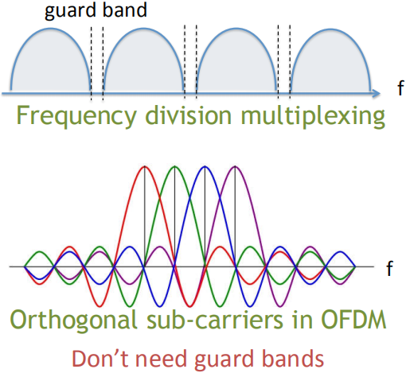
1 Why we need OFDM？
Advantage
1. OFDM can save frequency band and improve frequency band utilization rate
5

Slide 6
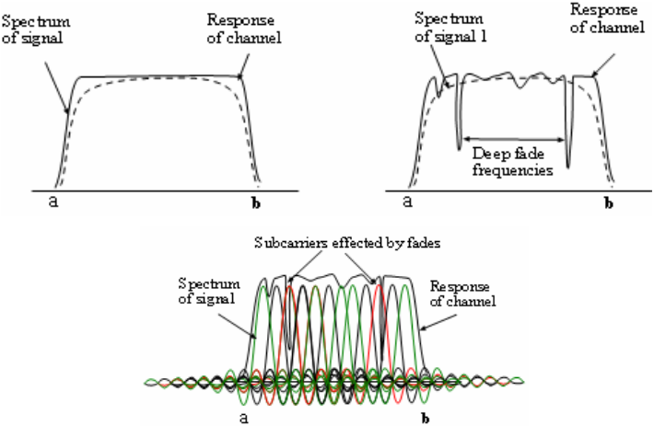
1 Why we need OFDM？
Advantage
2. OFDM can Against Frequency Selective Fading
6

Slide 7
02
What is OFDM？
7

Slide 8
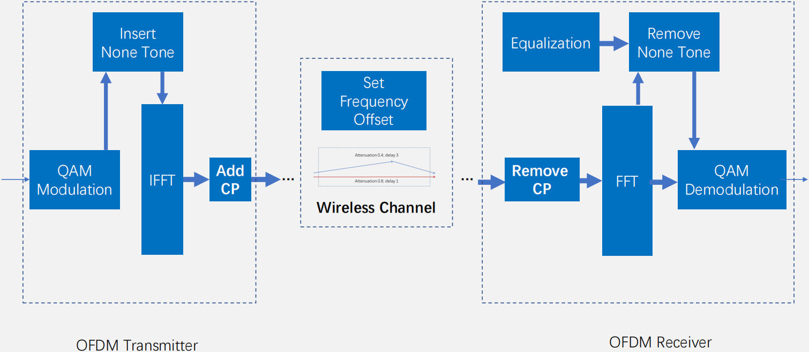
2 What is OFDM？
8

Slide 9
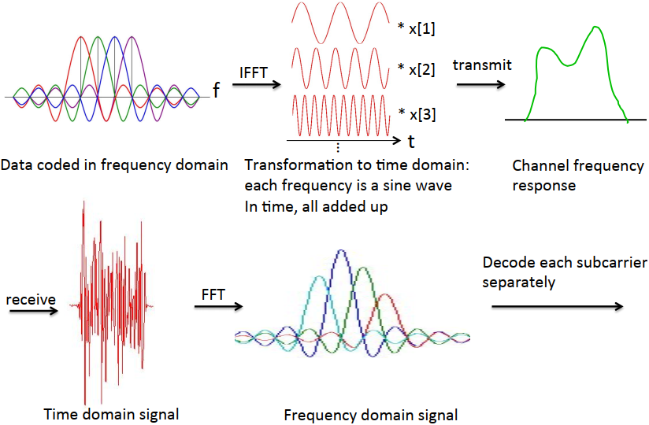
2 What is OFDM？
Main Purpose
8

Slide 10
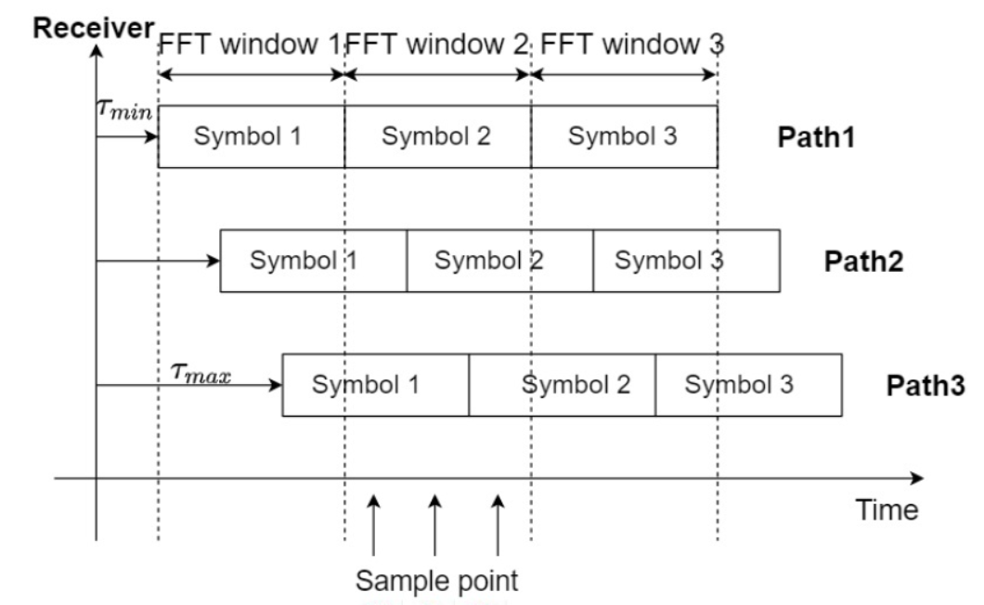
2 What is OFDM？
Adding CP
9

Slide 11
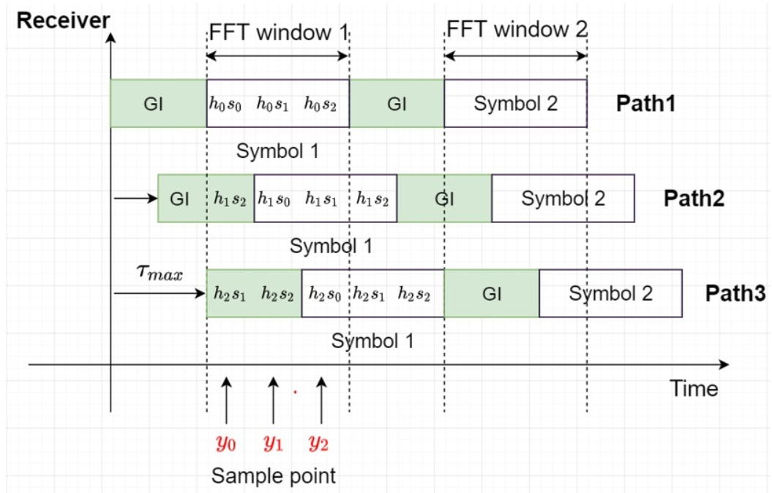
2 What is OFDM？
Adding CP
10

Slide 12
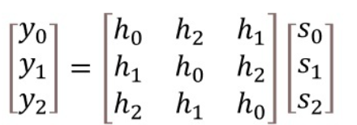
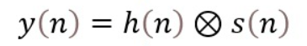
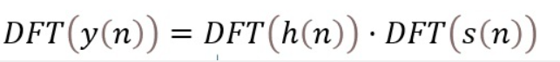
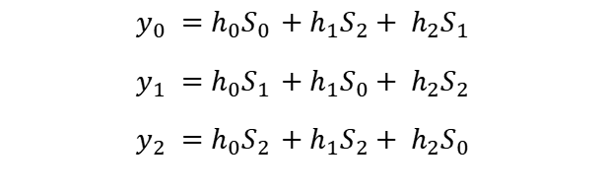
2 What is OFDM？
Simple analysis
$$y_{0} =h_{0}S_{0} +h_{1}S_{2}+ h_{2}S_{1}$$
$$y_{1} =h_{0}S_{1} +h_{1}S_{0}+ h_{2}S_{2}$$
$$y_{2} =h_{0}S_{2} +h_{1}S_{2}+ h_{2}S_{0}$$
Matrix form
Cyclic convolution
In frequency domain
10

Slide 13
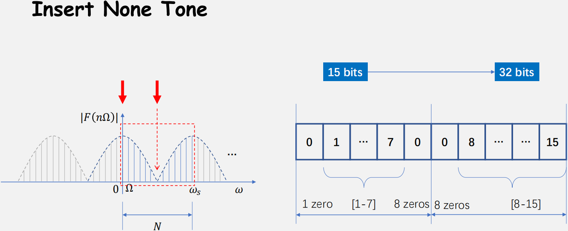
2 What is OFDM？
1. Insert 0 into the high-frequency component, which can not only avoid the transmission of high-frequency components, but also simulate the overlap between adjacent frequency bands.
2. Place the sequence we need to transmit at low frequency, while ensuring the specific length and can increase the length of the origin sequence of the each transmission sequence.
14

Slide 14

03
OFDM Transmitter
15

Slide 15
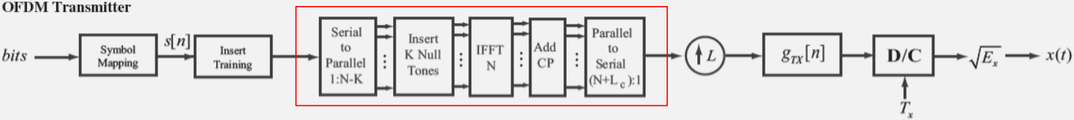
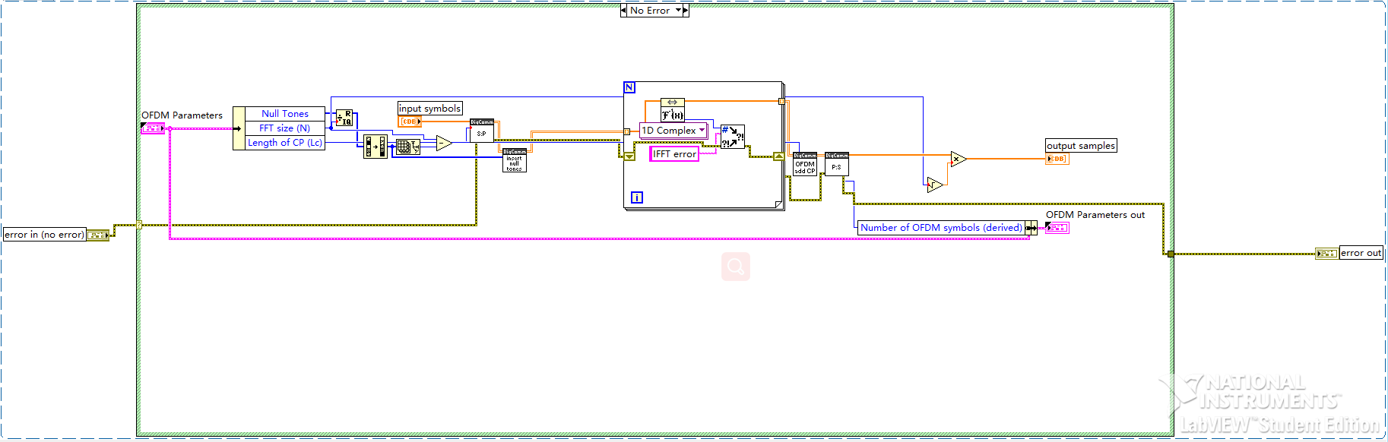
3 OFDM Transmitter
16

Slide 16
3 OFDM Transmitter
Convert serial input stream to parallel streams, block size=(N-K).
Insert null tones into each block at appropriate indices. Form framed matrix: Each row of framed matrix contains, a block of symbols which will be inputs for the IFFT.
Insert null tones into each block at appropriate index.
Perform IFFT (i.e. IDFT) on each framed block.
Add cyclic prefix.
Convert parallel streams in frame structure to serial sample sequence.
Scale energy to compensate for IFFT.
16

Slide 17
04
OFDM Receiver
17

Slide 18
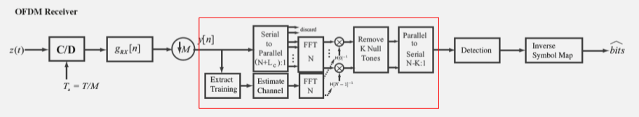
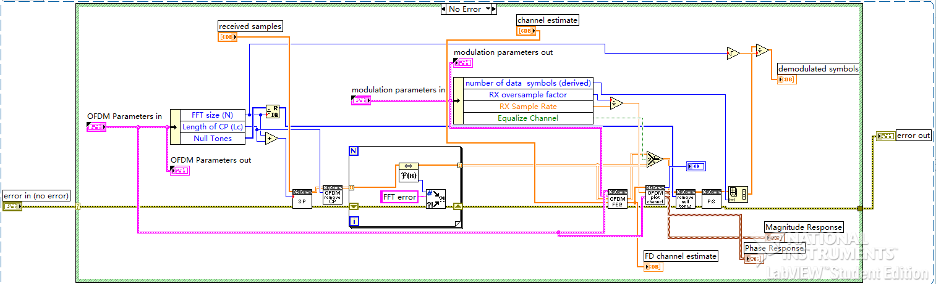
3 OFDM Receiver
18

Slide 19
3 OFDM Receiver
1. Convert serial input stream to parallel streams, blocksize = (N+Lc).
2. Strip cyclic prefix.
3. Perform FFT on each framed block.
4. Apply frequency domain equalizer (FEQ).
5. Remove null tones
6. Convert parallel streams in frame structure to serial sample sequence
7. Scale energy to compensate for scaling in transmitter
19

Slide 20
05
Basic Task 1
20

Slide 21
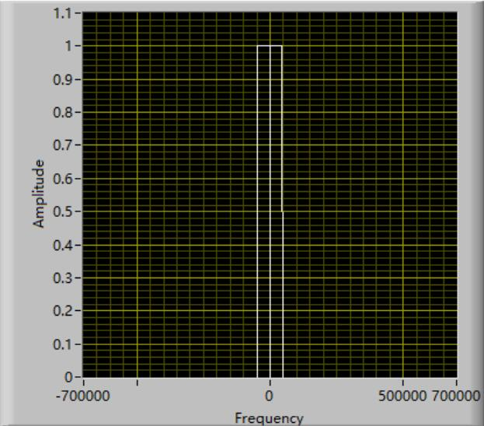
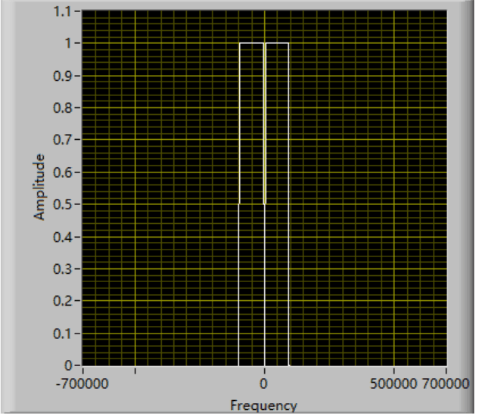
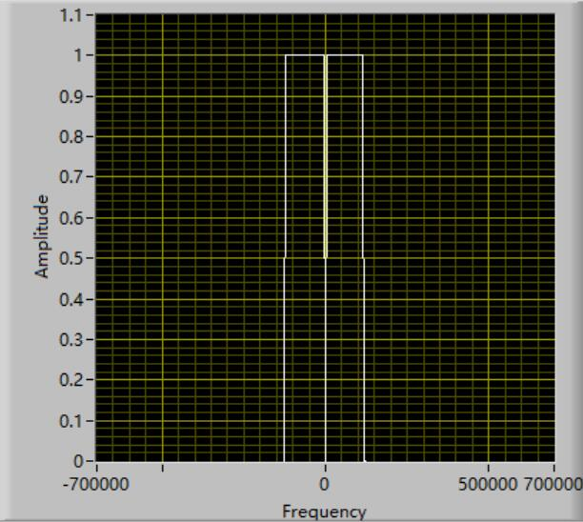
5
Basic Task1: Frequency Selectivity of Wireless Channels
Simulation
Sample Rate = 400KHz
Sample Rate = 800KHz
Sample Rate = 1MHz
21

Slide 22
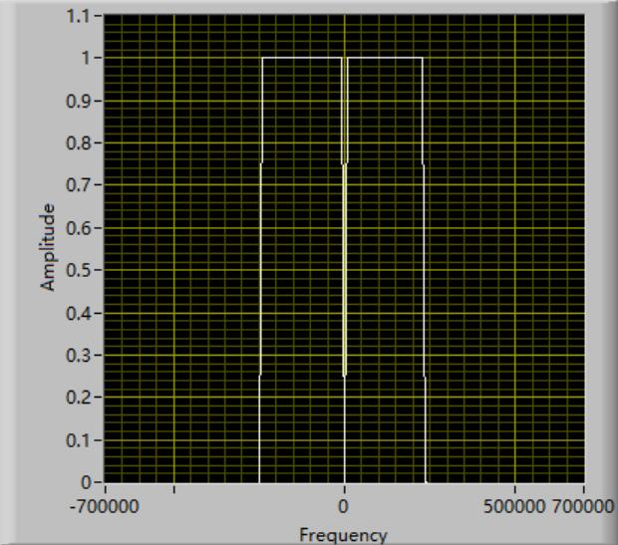
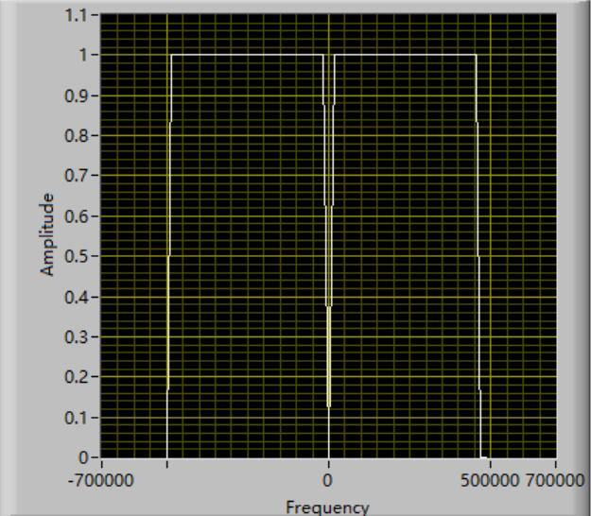
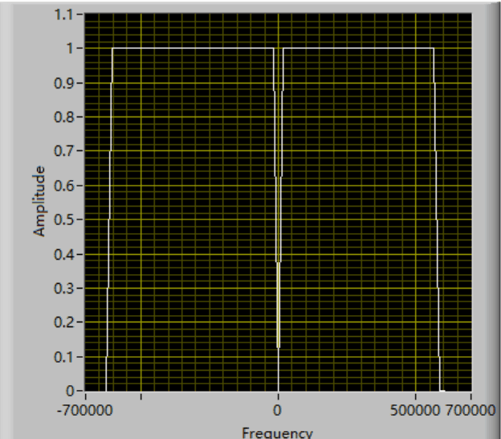
5
Basic Task1: Frequency Selectivity of Wireless Channels
Simulation
Sample Rate = 2MHz
Sample Rate = 4MHz
Sample Rate = 5MHz
As Sample Rate increases: Narrow band → Wide band;
Flat fading → Frequency selective fading.
22

Slide 23
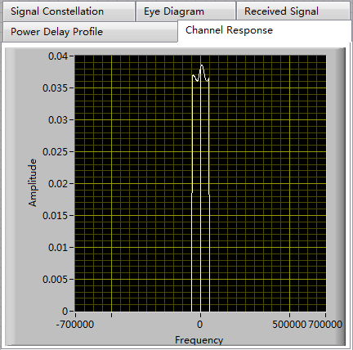
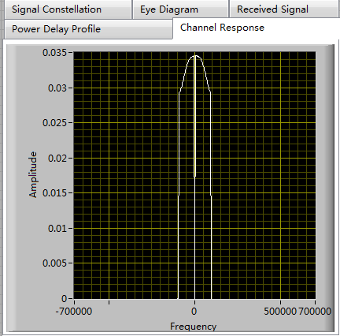
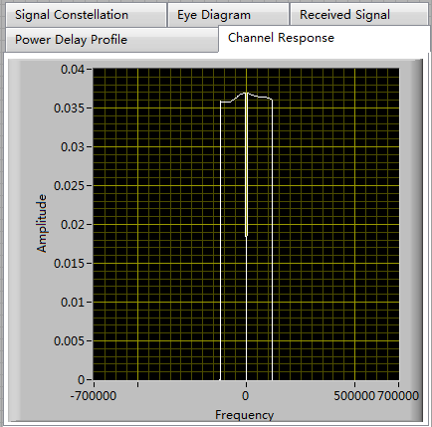
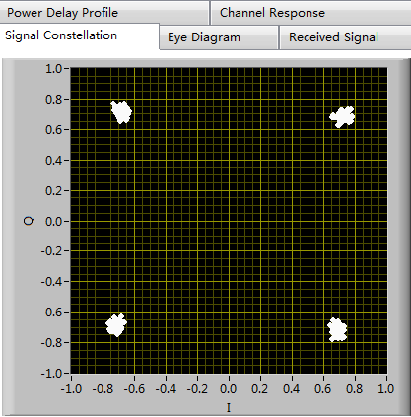
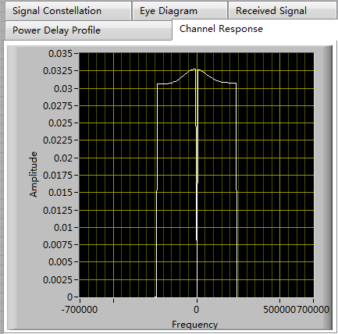
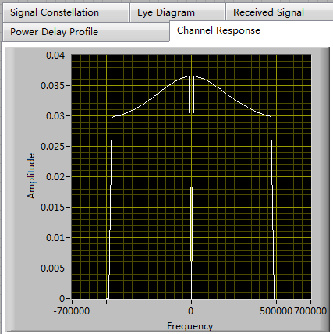
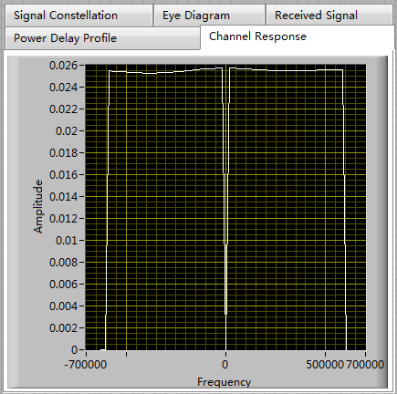
Basic Task1: Frequency Selectivity of Wireless Channels
5
USRP
Experiment
Sample Rate = 400KHz
Sample Rate = 800KHz
Sample Rate = 1MHz
23
Sample Rate = 2MHz
Sample Rate = 4MHz
Sample Rate = 5MHz

Slide 24
06
Bacic Task 2
24

Slide 25
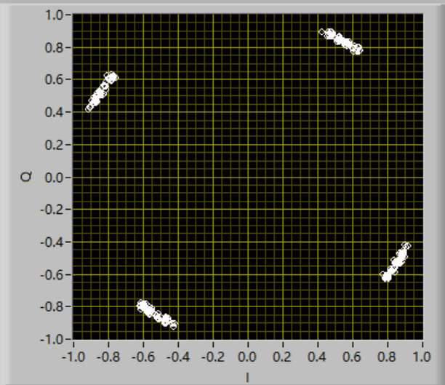
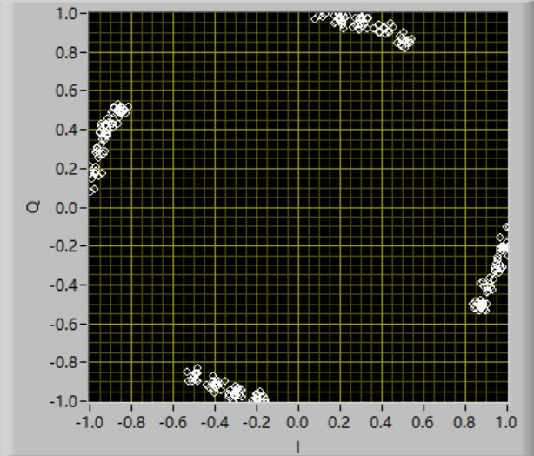
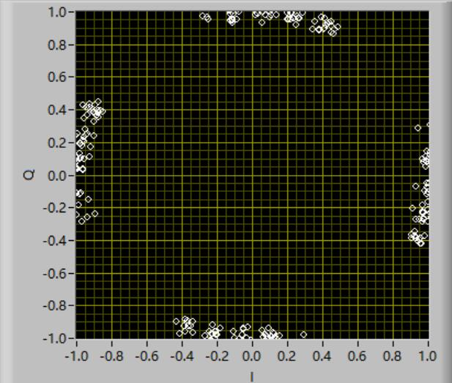
06
Basic Task2: Sensitivity to Frequency Offsets
N=64
Frequency Offset: 50 Hz
Frequency Offset: 100 Hz
Frequency Offset: 150 Hz
25

Slide 26
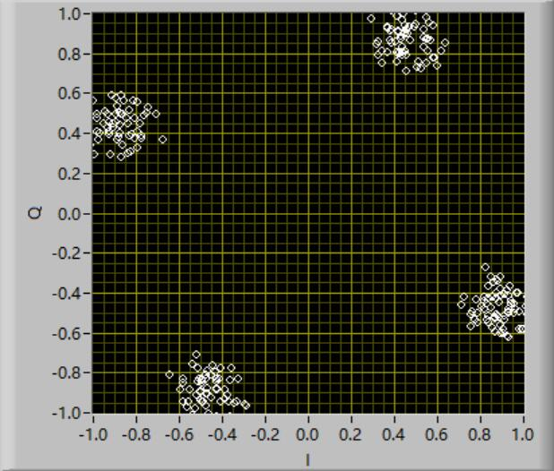
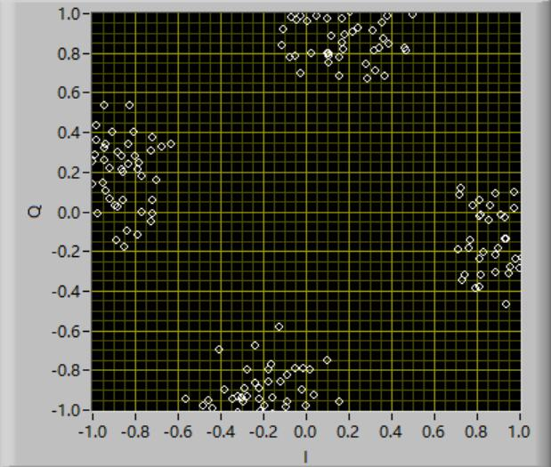
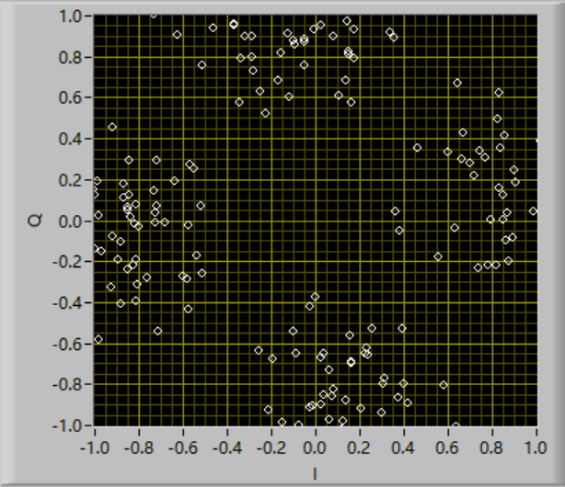
06
Task2: Sensitivity to Frequency Offsets
N=512
Frequency Offset: 50 Hz
Frequency Offset: 100 Hz
Frequency Offset: 150 Hz
26

Slide 27
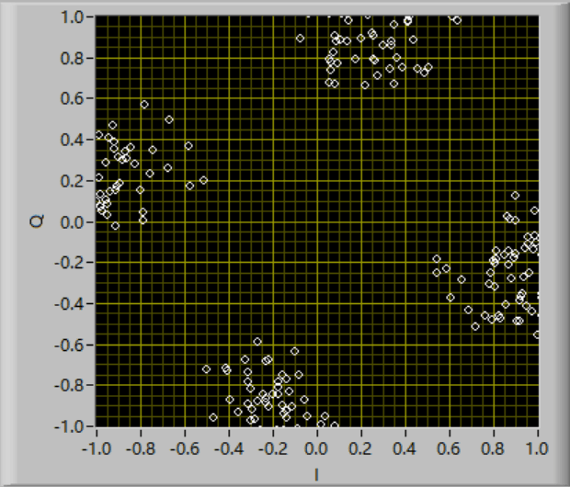
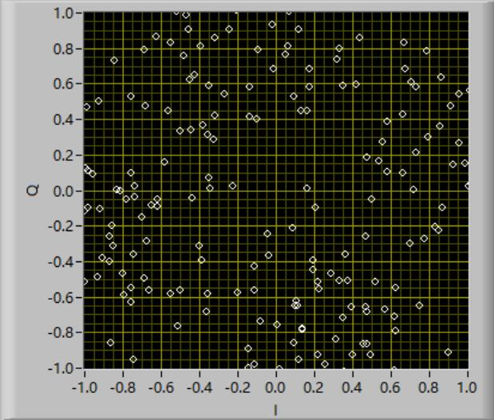
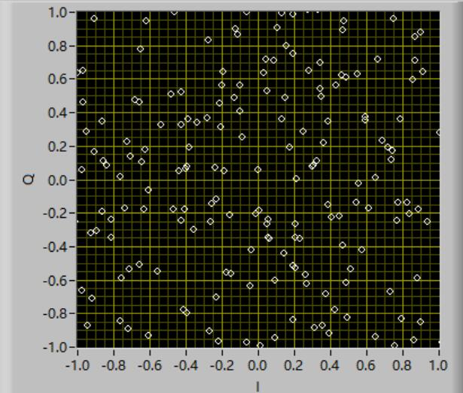
06
Task2: Sensitivity to Frequency Offsets
N=1024
Frequency Offset: 50 Hz
Frequency Offset: 100 Hz
Frequency Offset: 150 Hz
As the number of subcarriers increases, the recovery quality becomes worse.
27

Slide 28
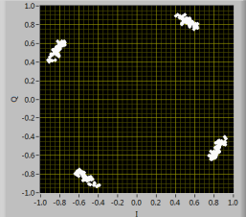
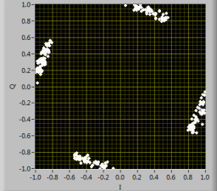
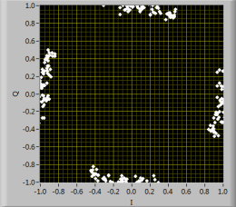
06
Task2: Sensitivity to Frequency Offsets
N=64
USRP Experiment
Frequency Offset: 50 Hz
Frequency Offset: 100 Hz
Frequency Offset: 150 Hz
28

Slide 29
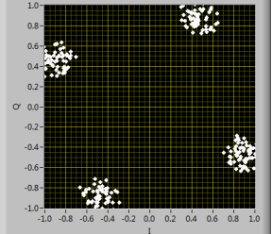
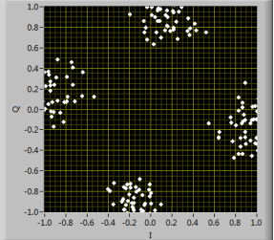
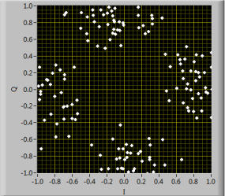
06
Task2: Sensitivity to Frequency Offsets
N=512
USRP Experiment
Frequency Offset: 50 Hz
Frequency Offset: 100 Hz
Frequency Offset: 150 Hz
29

Slide 30
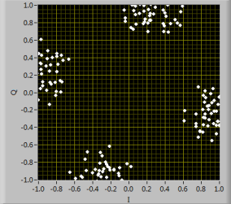
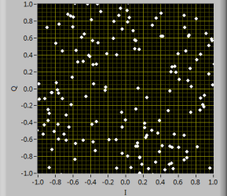
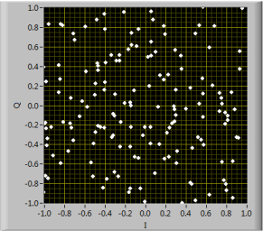
06
Task2: Sensitivity to Frequency Offsets
N=512
USRP Experiment
Frequency Offset: 50 Hz
Frequency Offset: 100 Hz
Frequency Offset: 150 Hz
30

Slide 31
06
Task2: Sensitivity to Frequency Offsets
Relation between Bit Error Rate and Frequency Offset
1. The BER increases as the frequency offset increases.
2. At the same frequency offset, the larger the number of subcarriers, the higher the BER.
31

Slide 32
07
Advanced Task 1
32

Slide 33
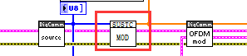
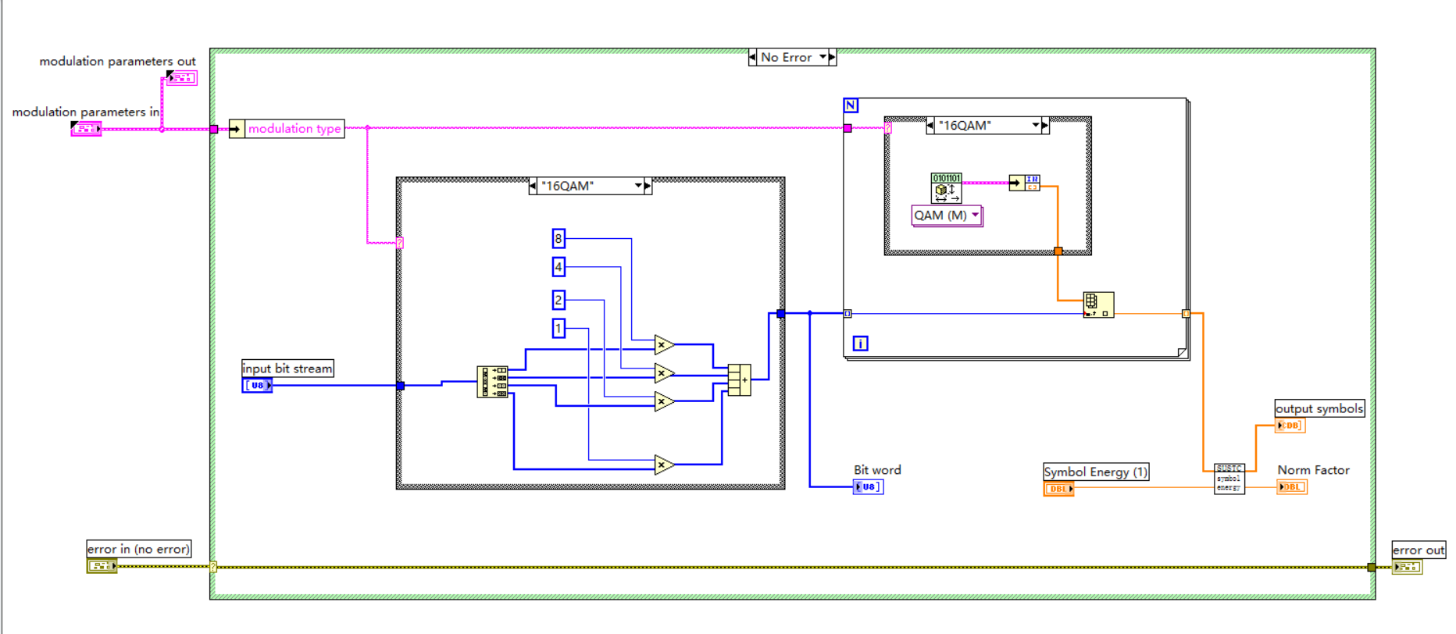
07
Advanced Task1: Higher order modulation
16-QAM
Modulation
33

Slide 34

07
Advanced Task1: Higher order modulation
64-QAM
Modulation
34

Slide 35


07
Advanced Task1: Higher order modulation
16-QAM
DeModulation
35

Slide 36

07
Advanced Task1: Higher order modulation
64-QAM
DeModulation
36

Slide 37




07
Advanced Task1: Higher order modulation（simulation）
16-QAM
64-QAM
37

Slide 38


07
Advanced Task1: Higher order modulation(USRP)
16-QAM
64-QAM
37

Slide 39
08
Advanced Task 2
38

Slide 40


07
Advanced Task2: Image transmission with OFDM
Transmitter
39

Slide 41


07
Advanced Task2: Image transmission with OFDM
Receiver
40

Slide 42


07
Advanced Task2: Image transmission with OFDM（Logo）
40

Slide 43
09
Experience
41

Slide 44


09
Experience1: 16QAM 64QAM init for transmitter and receiver
42

Slide 45


09
Experience2 16QAM 64QAM option setting
43

Slide 46

09
Experience3 USRP receiver error
44

Slide 47
09
Experience
Work arrangement
杨鸿嘉：发射端+Task 2+Advance 1+Advance 2+Debug
吉辰卿：理论分析+ 接收端 +Task 1+Advance 1+ PPT
45

Slide 48



THANK YOU

